Slide 1
Quierra
A solution to query your NoSQL Data
By Team Suits
Ayush Khasgiwala (2020201088)
Naman Jain (2020201080)
Somya Lalwani (2020201092)

Slide 2
Overview
Quierra is a fast and simple Browser tool to query our NoSQL data by uploading your JSON file on our website.
The output will be provided to the user in multiple formats, such as via HTML page, CSV/JSON format.

Slide 3
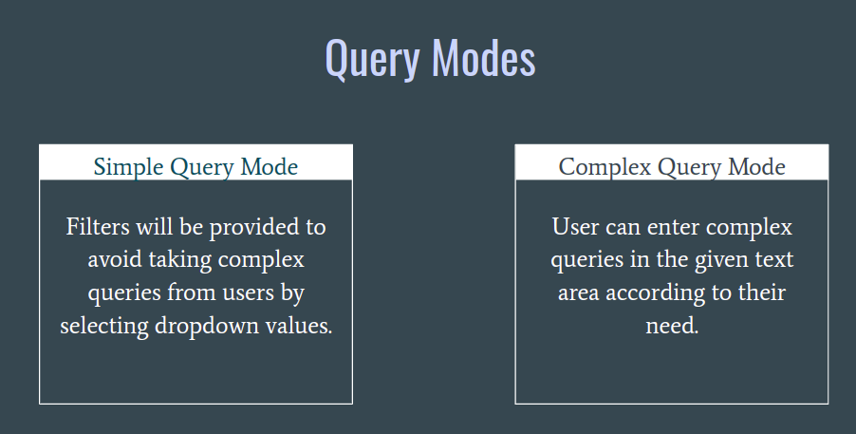
Key Requirements
Front-end of the application: The user will be provided with 2 interfaces: the simple query UI & the complex query UI
In simple query UI, the user will be given drop down menus which will change according to the previous choice. This will be a simplified interface version of simple queries.
The complex query UI will directly provide the query and the output will be provided.

Slide 4
Key Requirements
Back-end of the application: Different databases containing different tables will be provided as input to the application. The queries provided by the user will be processed (in real-time)in the backend on the dataset provided. Then the filtered data from the query i.e., the output will be displayed to the user.
Input format of the database is a zip file with name as <database_name>. The zip files contains multiple files <table_name>.json files, and each such file will have a corresponding metadata file.
Output of the query can be provided in 3 formats - displaying on the page itself, CSV file (download option provided), JSON file (download option provided)

Slide 5
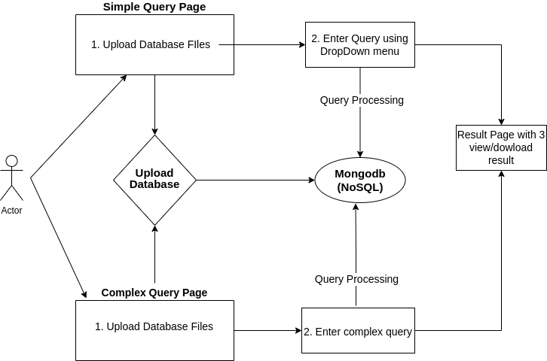
Design Requirements

Slide 6
Technology Used
Developed responsive website with the help of HTML, CSS, JavaScript, Ajax
Connected front end i.e. the web pages, with backend where the query processing is done using Flask web framework
For executing the queries, we have used MongoDB (a NoSQL database).

Slide 7
Screenshots

Slide 8
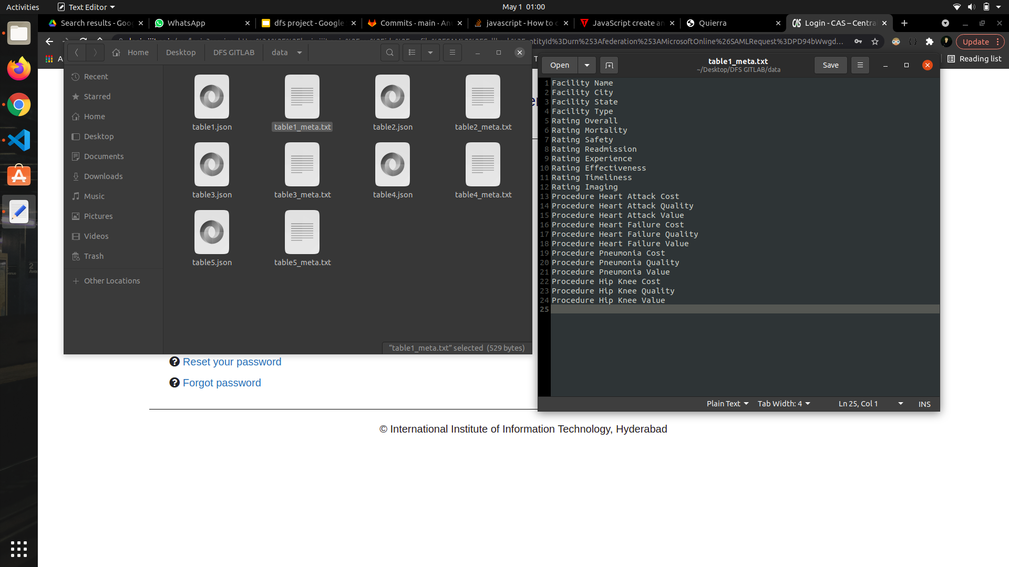
“Upload Database” Format

Slide 9
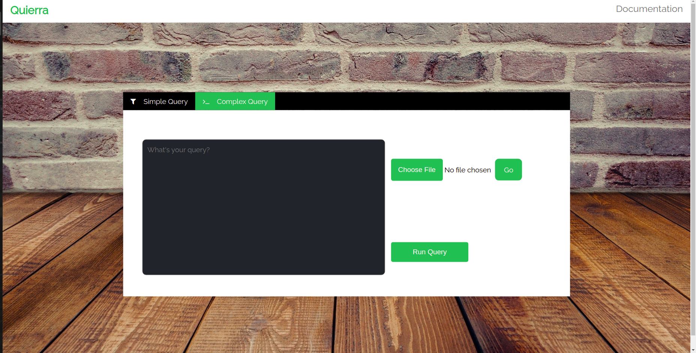
Complex Query page
Upload the database zip file first.
We can enter the query that we want to run in the black textbox.

Slide 10
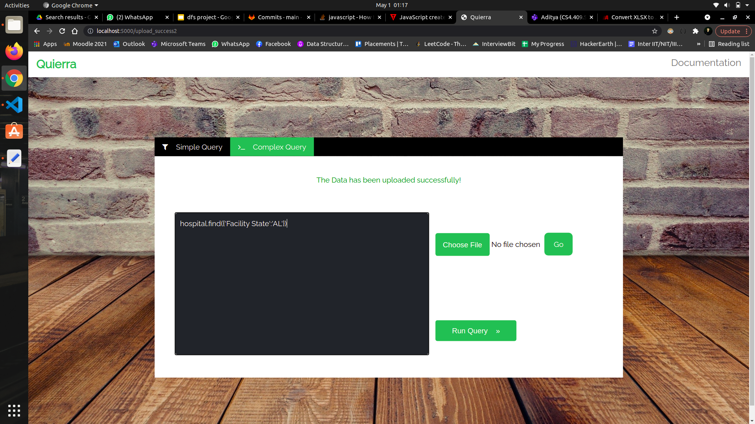
Complex Query page
On clicking ‘Run Query’, the query will be executed and page will be redirected to result page.

Slide 11
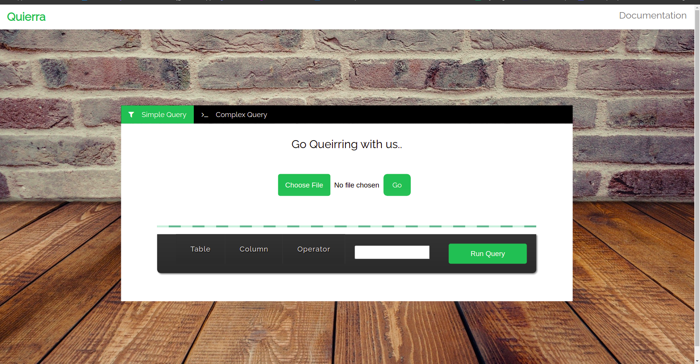
Simple Query Page
This is a simple query page that we made.

Slide 12
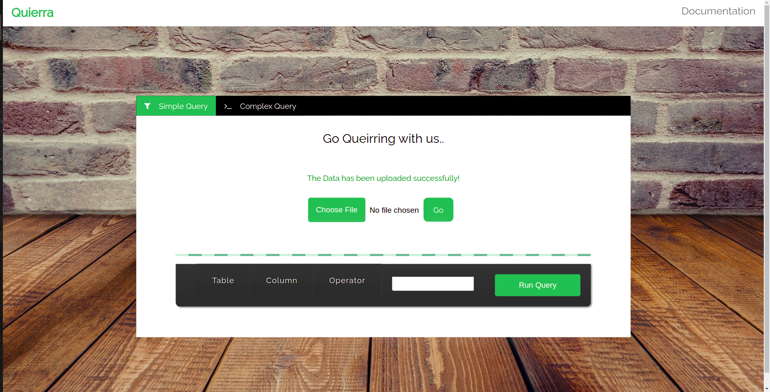
Simple Query Page
Upload the database zip file first.

Slide 13

Simple Query Page
At first Table name is selected from the drop-down, accordingly the column names come. Next 3 values to be selected for the query on the table are : Column name, options like >,<, =, etc. and the last a text-field for input value.
On clicking ‘Run Query’, the query will be executed and page will be redirected to result page.

Slide 14
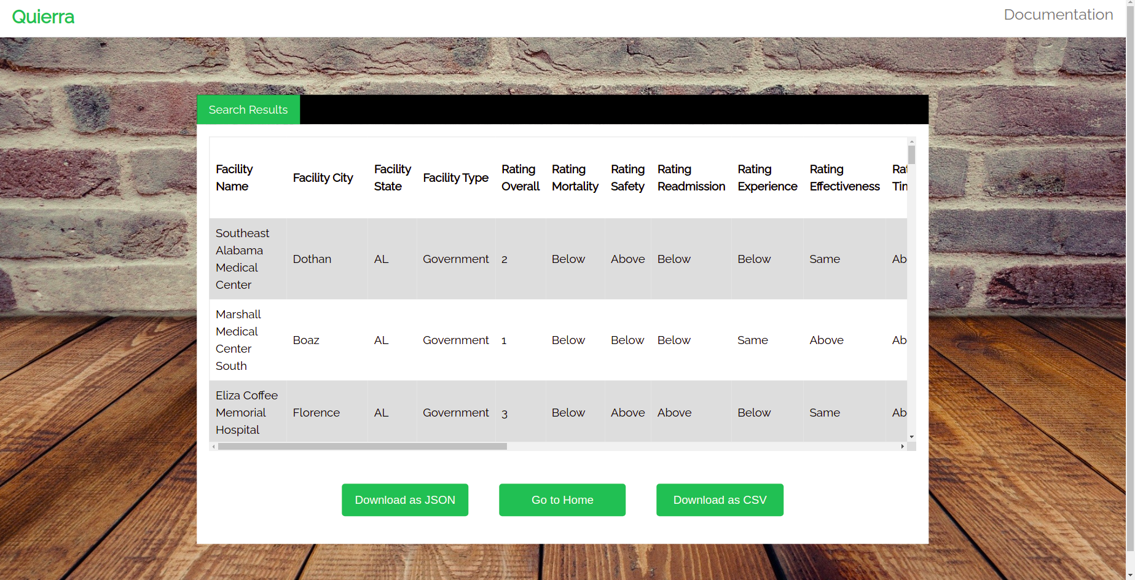
Output for given query

Slide 15
Individual Contribution
Ayush Khasgiwala
Searching Dataset for this project
Web Page and Database connectivity using Flask
Project Deployment
Naman Jain
Searching Dataset for this project
UI Design and Development using HTML, JS, AJAX, CSS.
Project Deployment
Somya Lalwani
Searching Dataset for this project
Query Execution using MongoDB
Project Deployment
Apart from these individual tasks, all 3 of us helped each other in debugging and merging code

Slide 16
Thank You !

